Slide 1

FIR Filter
By: Hamza Ali Morsi

Slide 2
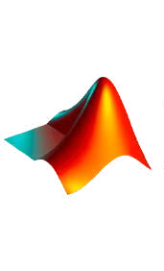


Design Flow
FIR Filter Using Matlab
FIR Filter RTL Desgin
Simulation for the FIR
ASIC FLOW

Slide 3
What is a Filter
a filter is by an incredibly broad definition any medium through which a signal passes can be regarded as a filter however we do not usually think about something as a filter unless it can modify the signal in some way
Filters are used in many disciplines. For example, image processing makes heavy use of 2D filters, where the input and output are images. You might use a filter every morning to make your coffee, which filters out solids from liquid. In DSP,
filters are primarily used for:
Separation of signals that have been combined (e.g., extracting the signal you want)
Restoration of signals that have been distorted in some way (e.g., an audio equalizer is a filter)
Removal of excess noise after receiving a signal

Slide 4
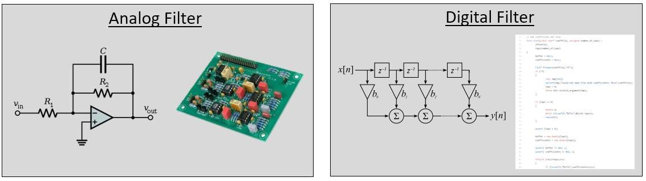
What is a Filter
In electronics there are 2 main types of Filters: Analog Filters and Digital Filters

Slide 5
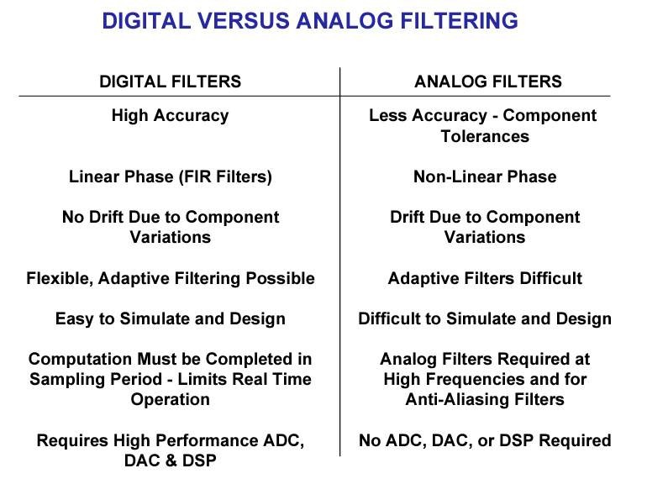
Why use Digital Filters

Slide 6
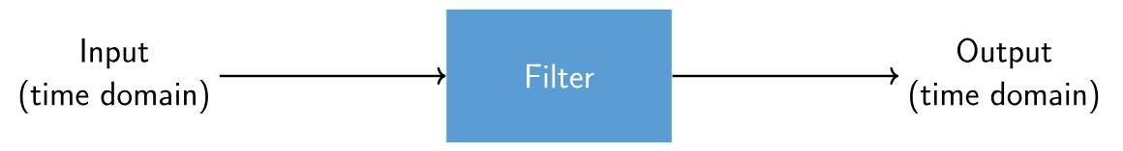
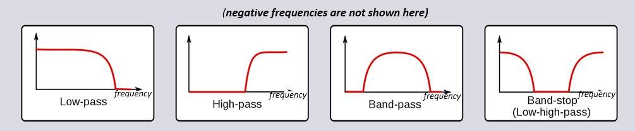
Types of Filters

Slide 7
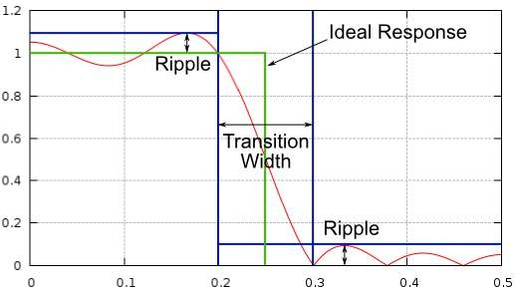
Filter Characteristics
In the case of the low-pass fEach filter permits certain frequencies to remain from a signal while blocking other frequencies. The range of frequencies a filter lets through is known as the “passband”, and “stopband” refers to what is blocked.
ilter, it passes low frequencies and stops high frequencies, so 0 Hz will always be in the passband. For a high-pass and band- pass filter, 0 Hz will always be in the stopband.
‘’Transition width’’, also measured in Hz, instructs the filter how quickly it has to go between the passband and stopband since an instant transition is impossible.

Slide 8
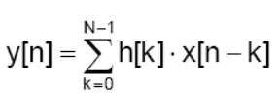
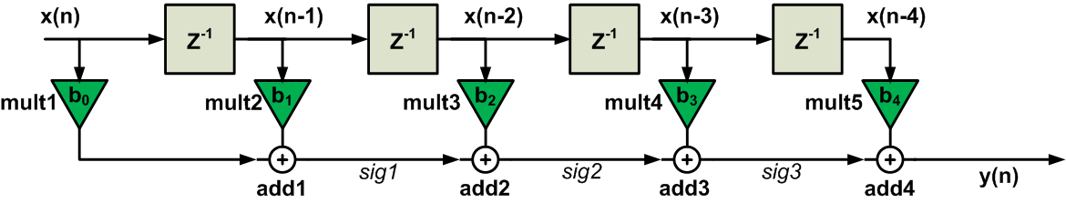
FIR RTL Design
this is the archeticture of 4th order Direct Form FIR lets break each block quickly x(n): is just your input signal at the present time
Z^-1: delay block by one cycle you can think of it as a register which delay the input till the next cycle
x(n-2): the input signal delayed by 2 cycles
the green triangle is our TAP or a multiplier which multiply your input signal with the coefficient and at the end you have an adder which sums all the result of the multipliers

Slide 9
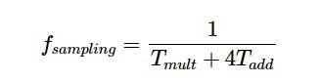
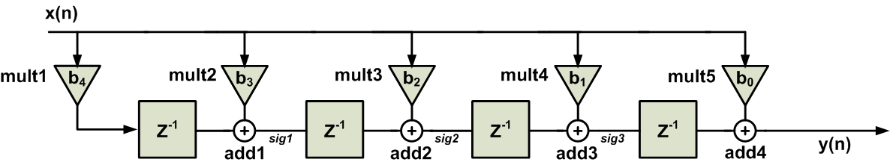
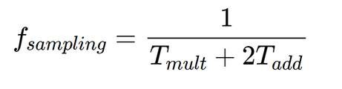

Transposed VS Direct Form
Critical Path = one mult + N*adders where N equals FIR order
Critical Path = one mult + one adder whatever the order of the FIR
now you know why we choosed transposed form in matlab filter designer and this is the fir arch that we will write RTL for

Slide 10
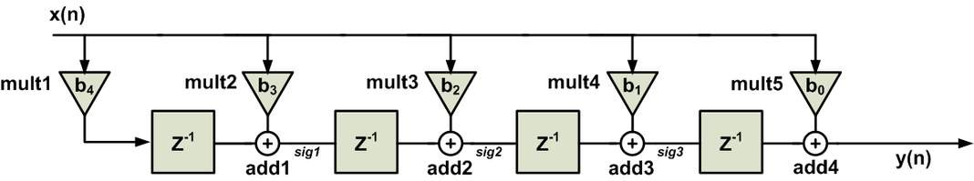
Making a Genric FIR
Finding a pattern in the FIR Archeitecture
We can now just write the rtl for the fir we want and accoriding to the fir filter order the amount of code will be determined but since we want to design a genric filter we will make it with another way. we will design fir with order 1 in a seperate module and then in another module replicate it as many times as you want using For Generate Block according to a parameter
Whatever the order of the filter is it will consist of the same thing
Transposed FIR = one mult(in blue box) + N(Trasnposed Block) where N is filter order and Trasnposed block is the Block inside the red Box
Now lets Write the RTL for a single Transposed block

Slide 11
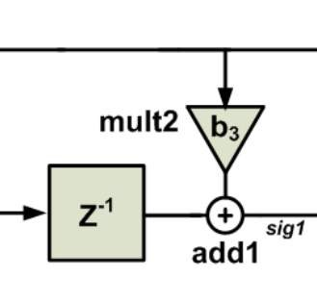
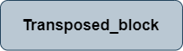
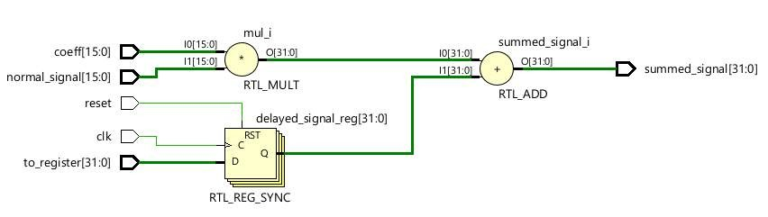
RTL Viewer

Slide 12
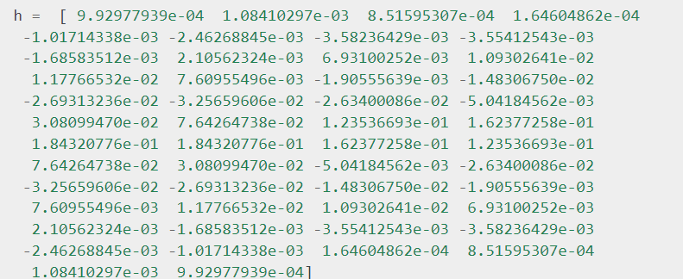
Filter Characteristics
Here is an example of a set of filter taps or Coefficients, which define one filter
For most filters we will see (known as FIR, or Finite Impulse Response, type filters), we can represent the filter itself with a single array of floats. For filters symmetrical in the frequency domain, these floats will be real (versus complex), and there tends to be an odd number of them. We call this array of floats “filter taps” or Coefficients. We often use ‘h’ as the symbol for filter taps.
We get these cofficients by using MATLAB Filter Designer

Slide 13
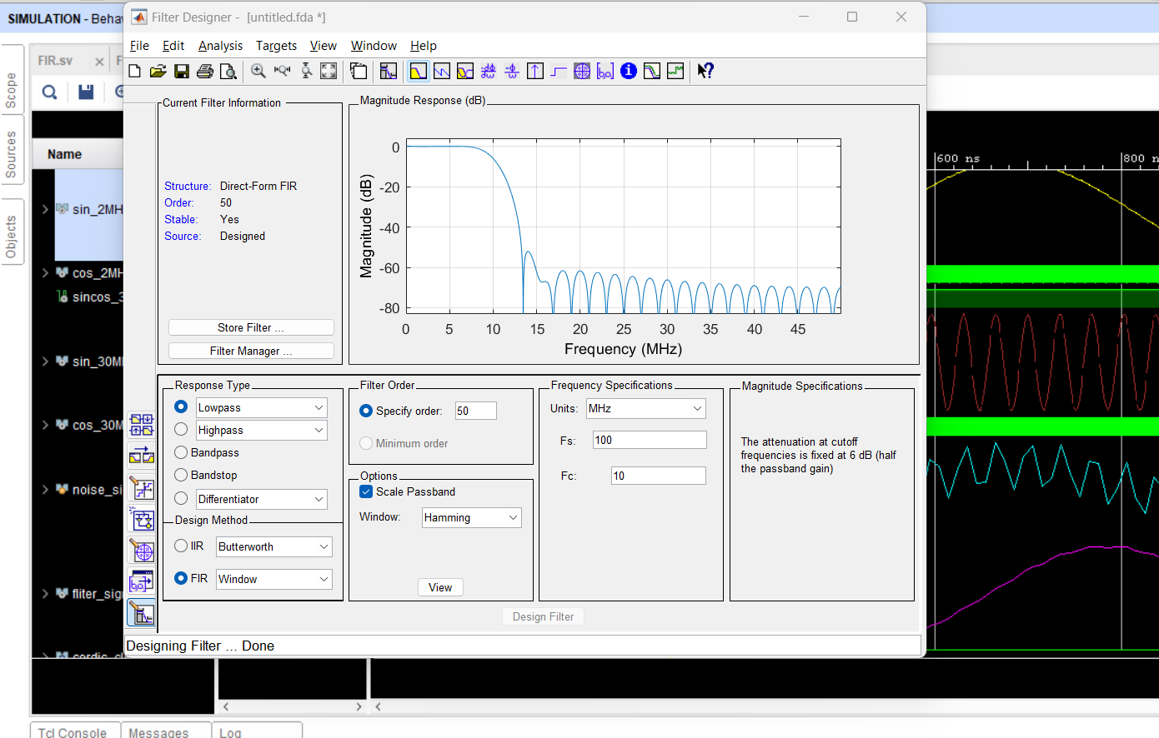
Filter Design Usign Matlab
as a start we will design a 50th Order Low pass FIR filter with hamming window
Cutoff Freq. = 10MHz Sampling Freq. = 100 MHz
Structure: Transposed
(we will get to the difference btw transposed and direct form later)

Slide 14
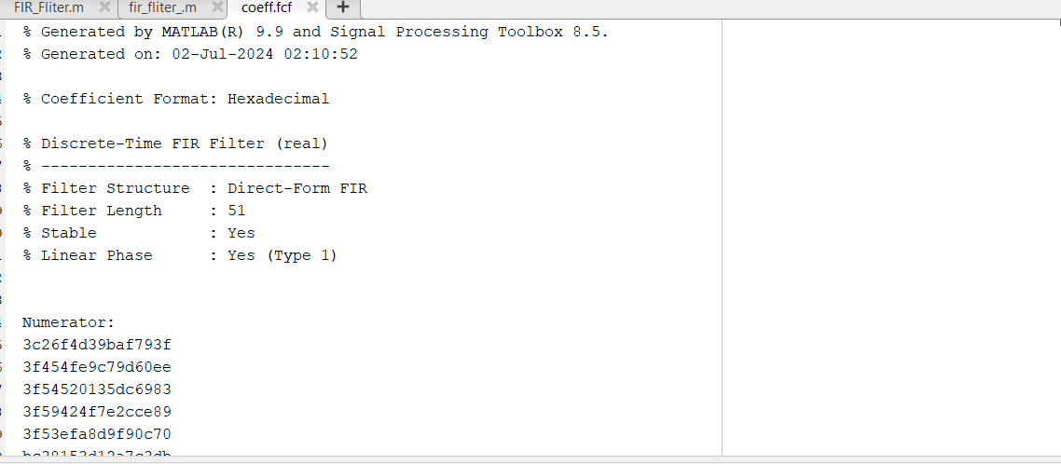
we generate the Coefficients for the filter “File” >> “Export” >> under “Export to” Click Coefficents ASCII >> then Choose Decimal
Small Note: Number of Coefficients or TAPS is higher than the filter order by 1 so 50th order filter will have 51 cofficients and we will see this in the FIR Archeticture

Slide 15
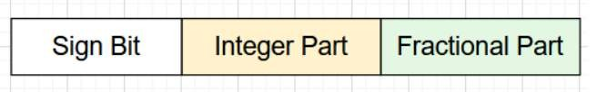
We now want to represent the Floating point Coefficients into binary numbers
we will use Fixed Point Representation and since some of the coeffs are -ve and some are +ve we will use the Signed Version
let the TAP size be 16 bits
we will reserve the MSB for the sign (1 bit)
since all coeffs are less than 1 we dont need any bits for the integer part (0 bit)
and the rest of the bits for the fractional part (15 bits)
to represent n-bit fractional number, multiply fractional part by 2^n
if +ve >> round the result off
if -ve >> round the result off >> get 2's complement
EX1: -0.000101679 * 2^15 = round off(-3.3318) = -3
3 in binary >> 0000_0000_0000_011 2's complement >> 1111_1111_1111_101
EX2: 0.00189838 * 2^15 = round off(62.206) = 62
62 in binary >> 0000_0000_0111_110

Slide 16
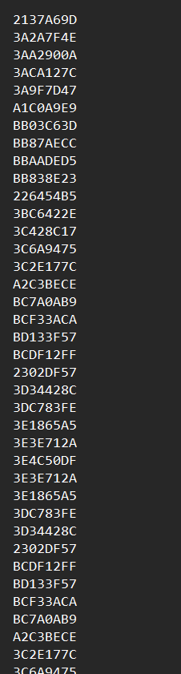
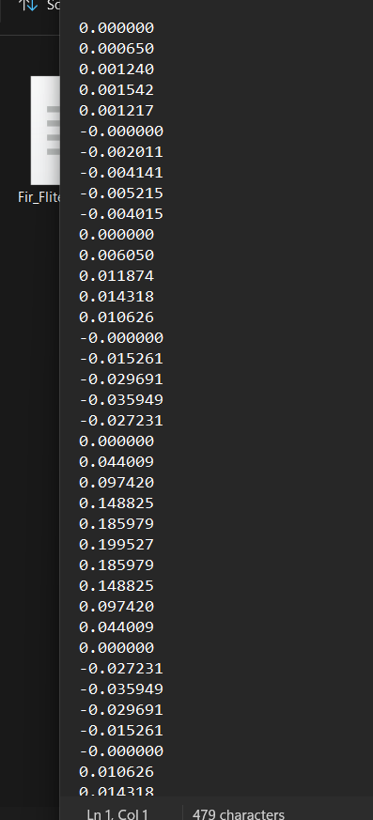
1st Example
2nd Example
Python Script

Slide 17
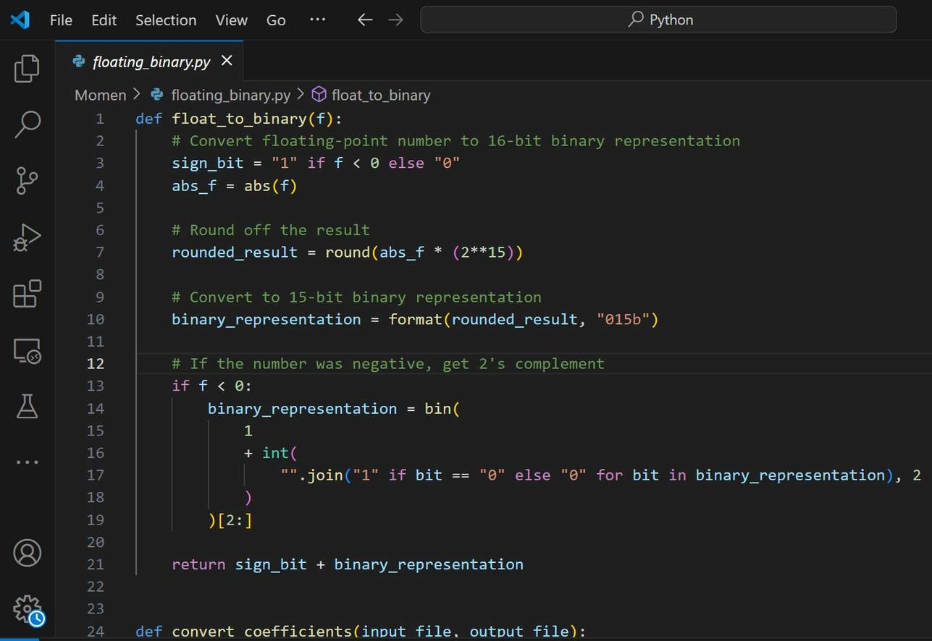

Automating TAPS Conversion
as you saw converting each coefficient from floating to binary takes time so we will make a Python script which take the coeffs file as input and give you the binary equivalent of each coeffs so we can use it in our RTL design
To Check the rest of the code go to GitHub

Slide 18
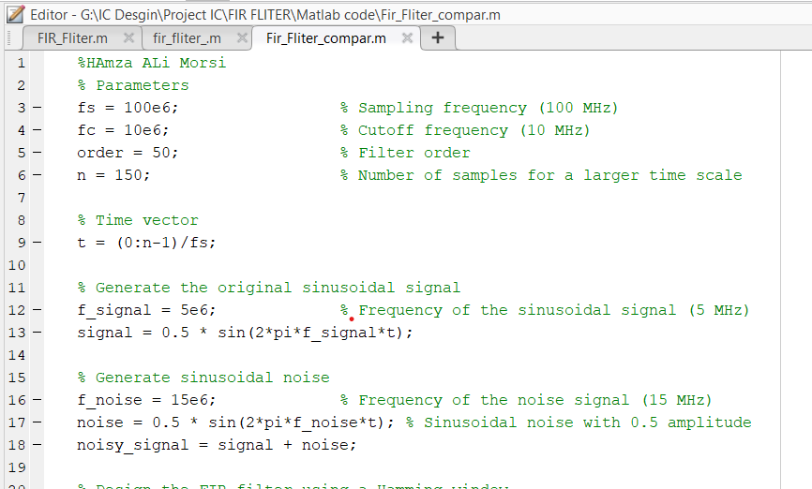
Matlab Script for the fir Filter
After we got the coefficients from matlab we need to write a matlab code to model our FIR fitler to use as our golden model we will compare the output of the RTL to this model later in Verification Stage

Slide 19
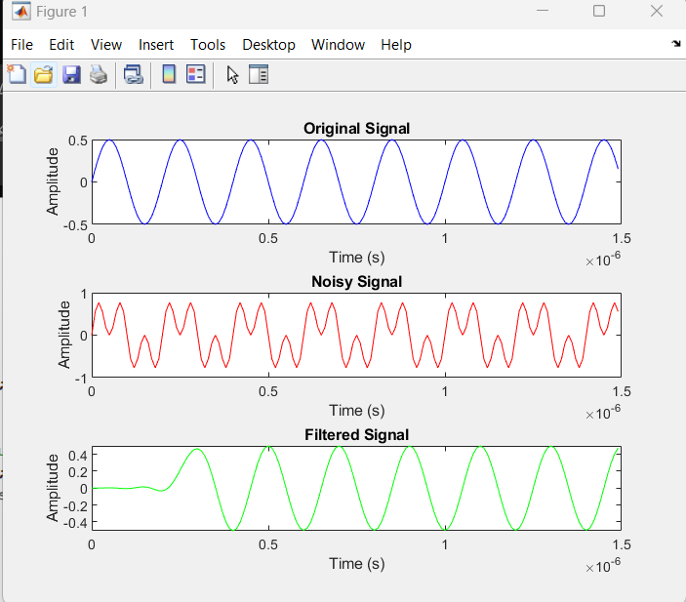
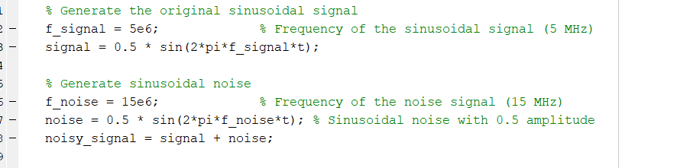
Testing the Matlab Script

Slide 20
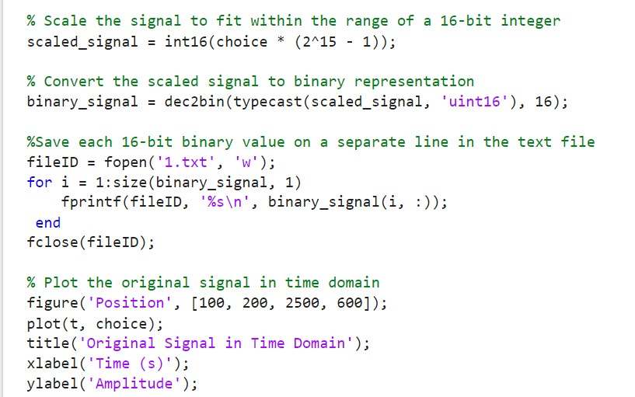
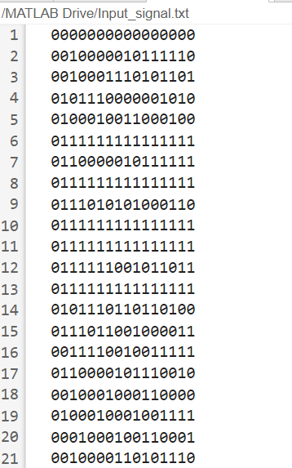
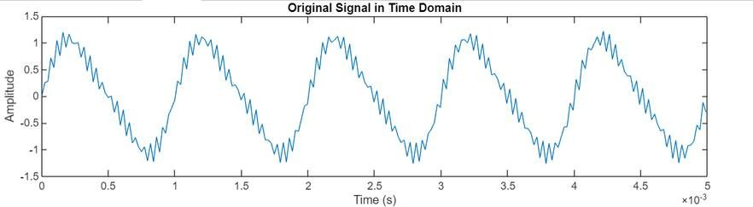
Matlab Script for Signal Generation
we use the same signal we applied on the filter designed in matlab before

Slide 21
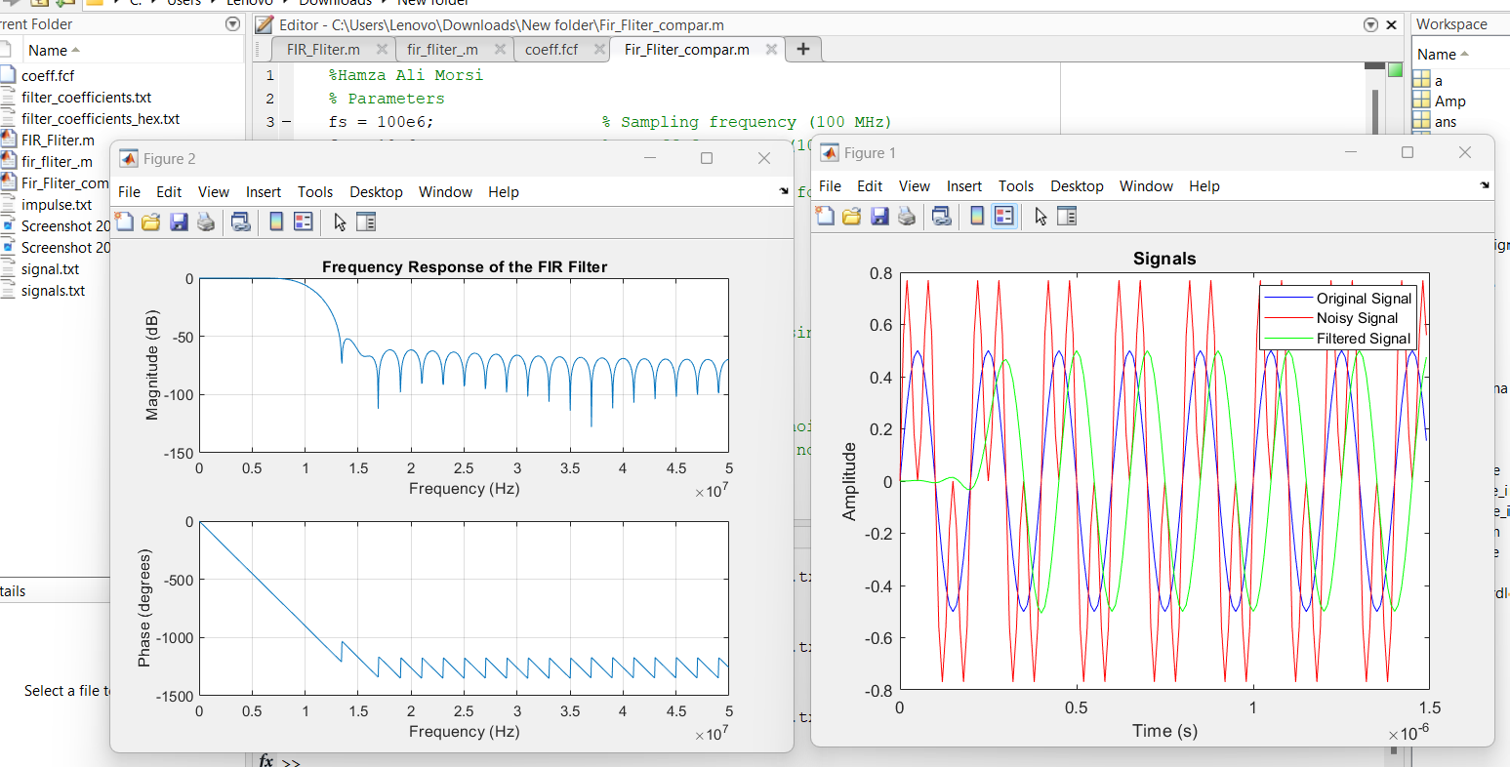

Slide 22
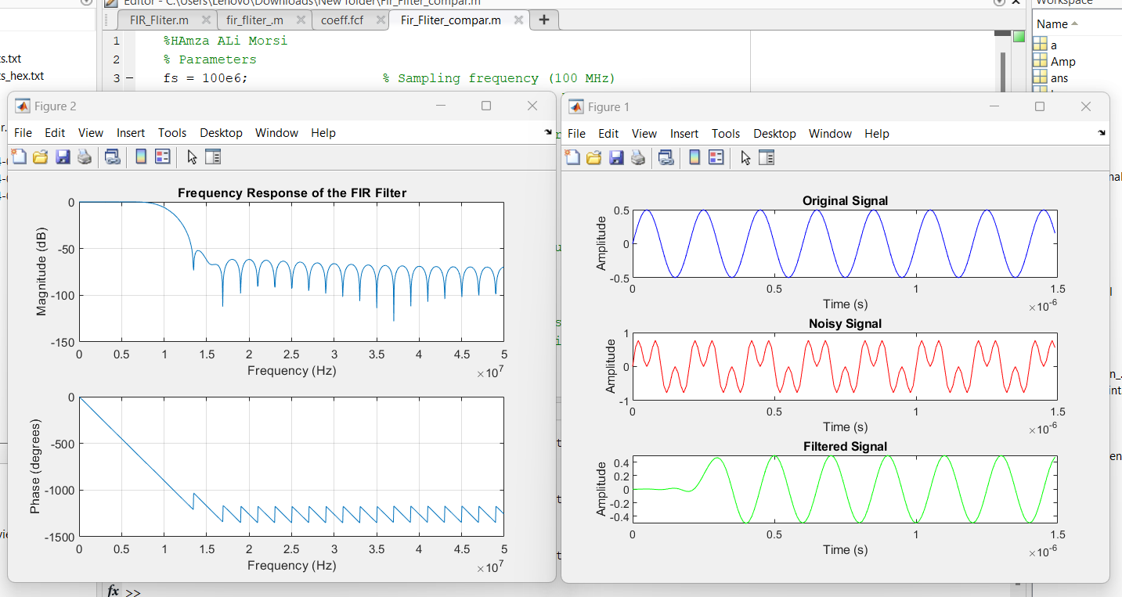

Slide 23
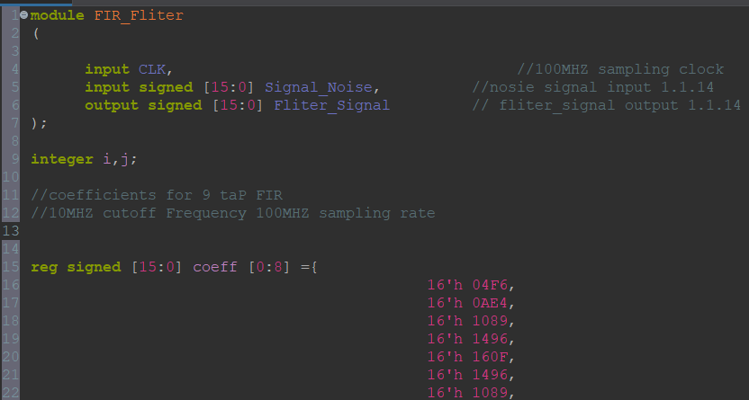
Block RTL
To Check the rest of the code go to GitHub

Slide 24
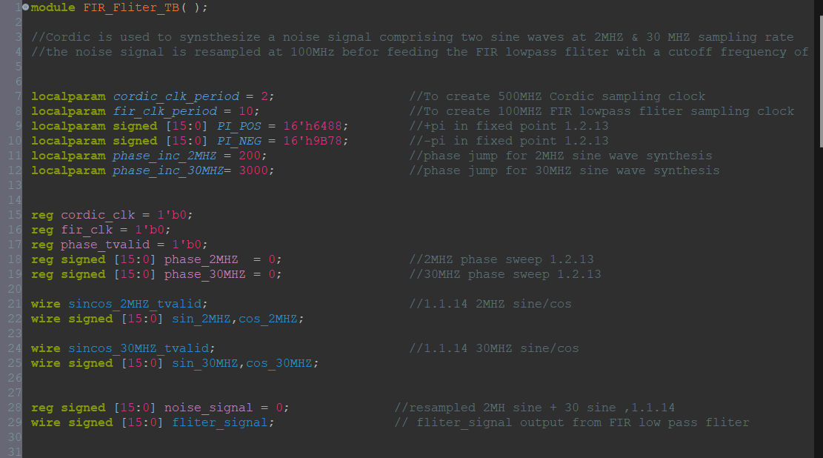
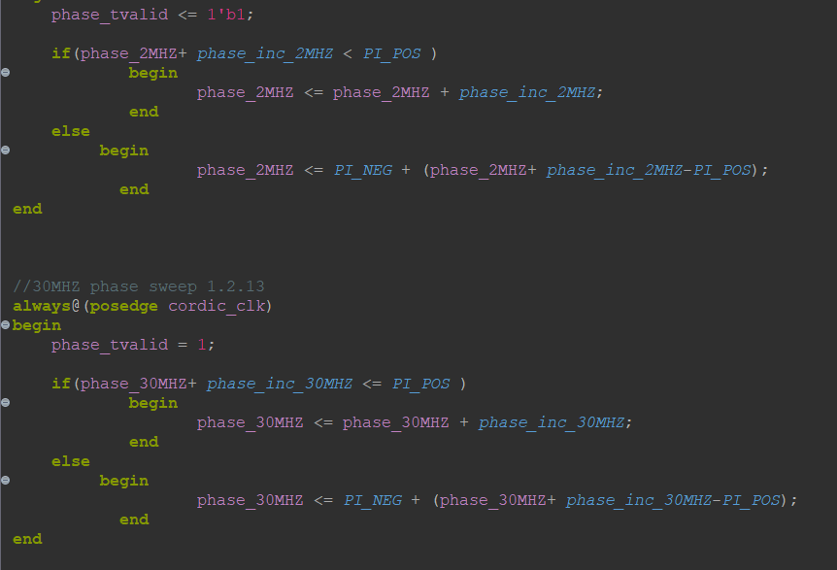
Testbench

Slide 25
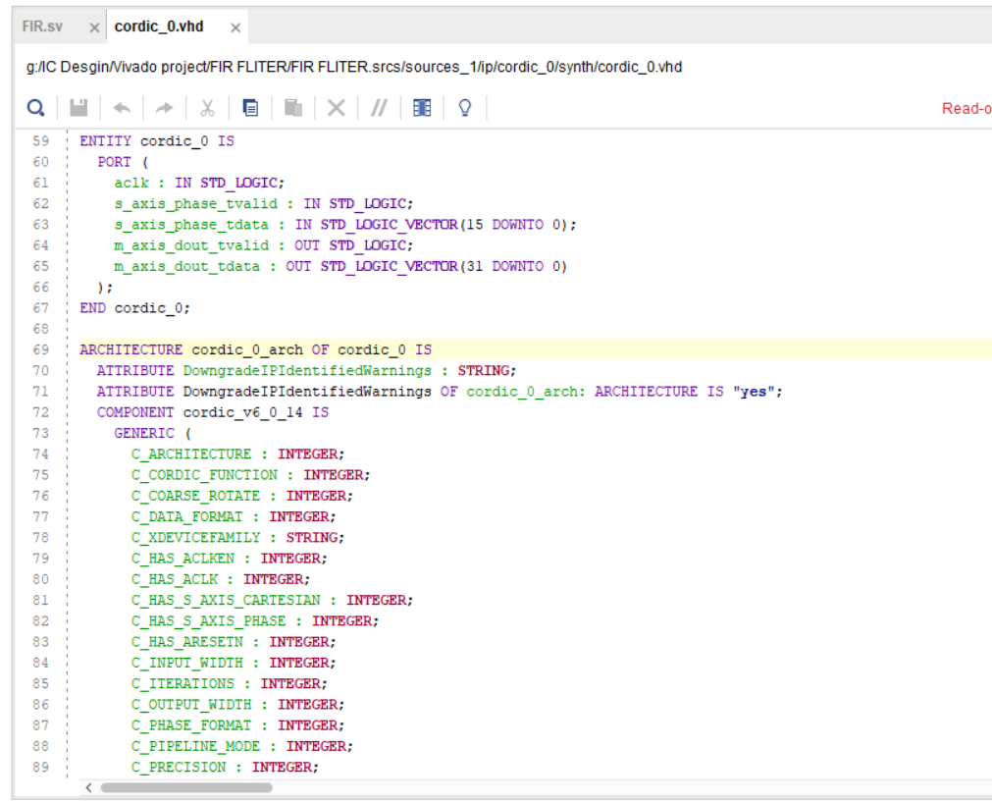
The CORDIC (Coordinate Rotation Digital Computer) function in VHDL is used to efficiently compute trigonometric functions such as sine and cosine. It performs iterative rotation operations using only addition, subtraction, and bit-shifting, making it well-suited for hardware implementation. In a typical VHDL implementation, the CORDIC function initializes angle, sine, and cosine registers, and iteratively updates these values based on precomputed arctangent values and bit-shift operations. This function is particularly useful for digital signal processing applications, such as FIR filters, where trigonometric computations are required.

Slide 26
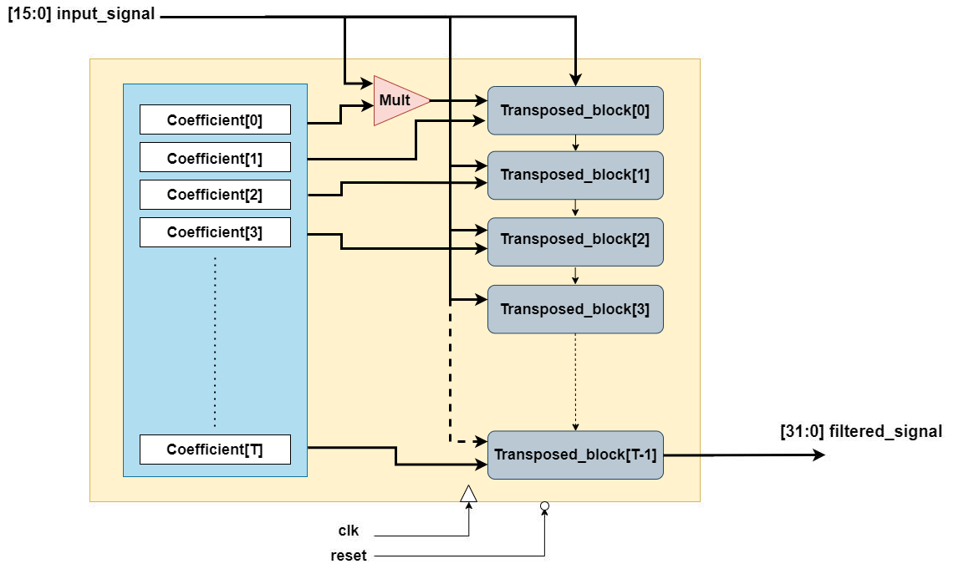
Generic FIR Archeitecture
the blue block is a ROM for the coefficients and then the transposed block are replicated using for generate according to a parameter caleed ‘’T’’ which is equivalent to number of TAPS
the TAPS = Filter Order + 1

Slide 27
Simulation of FIR
to simulate the fir now we have to generate a signal to filter it. as I worked through this project I saw many ways to generate the signal I will mention them and we will use the easieset one among them
Using Matlab to generate you a signal in form of sampled amplitudes and then store them into the input memory
(thats why we added a rom for the input because we will use this method :)
using CORDIC algorithm
Design a DDS (Direct Digital Synthesizer) module
Using a numerically controlled oscillator (NCO) IP

Slide 28
Simulation of FIR

Slide 29
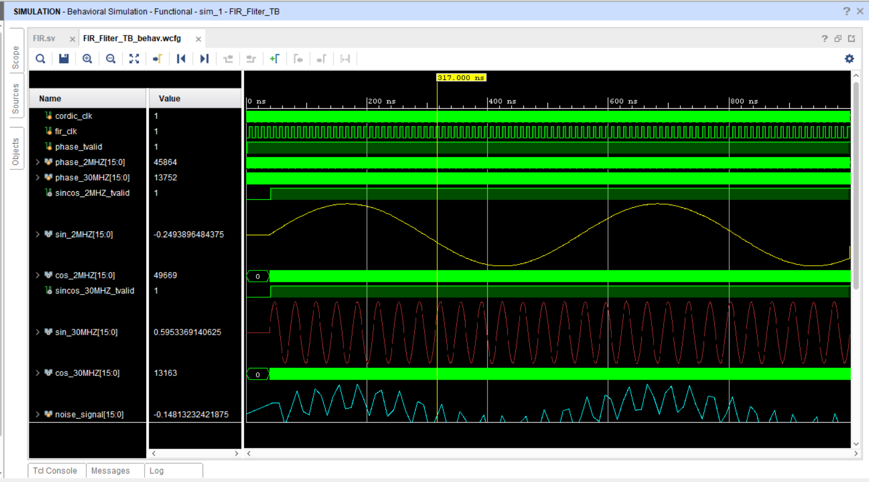

Slide 30
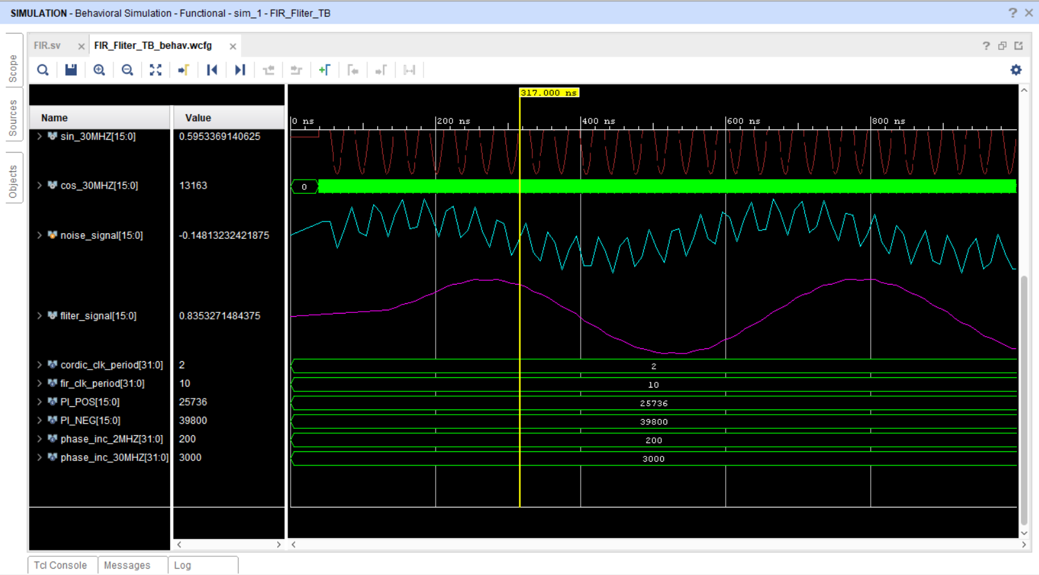

Slide 31
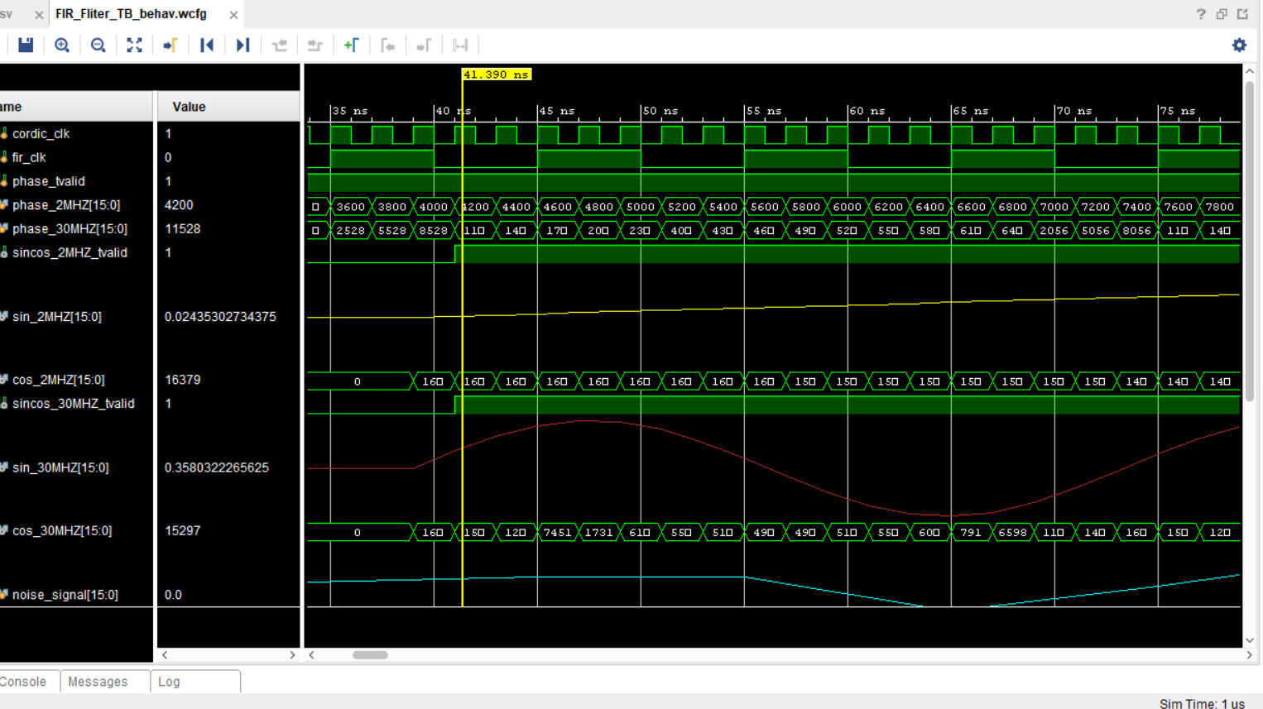

Slide 33
Backend flow

Slide 34
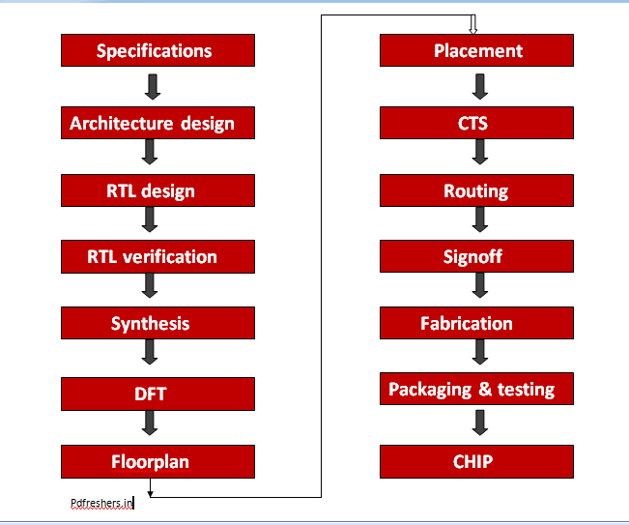

Slide 35
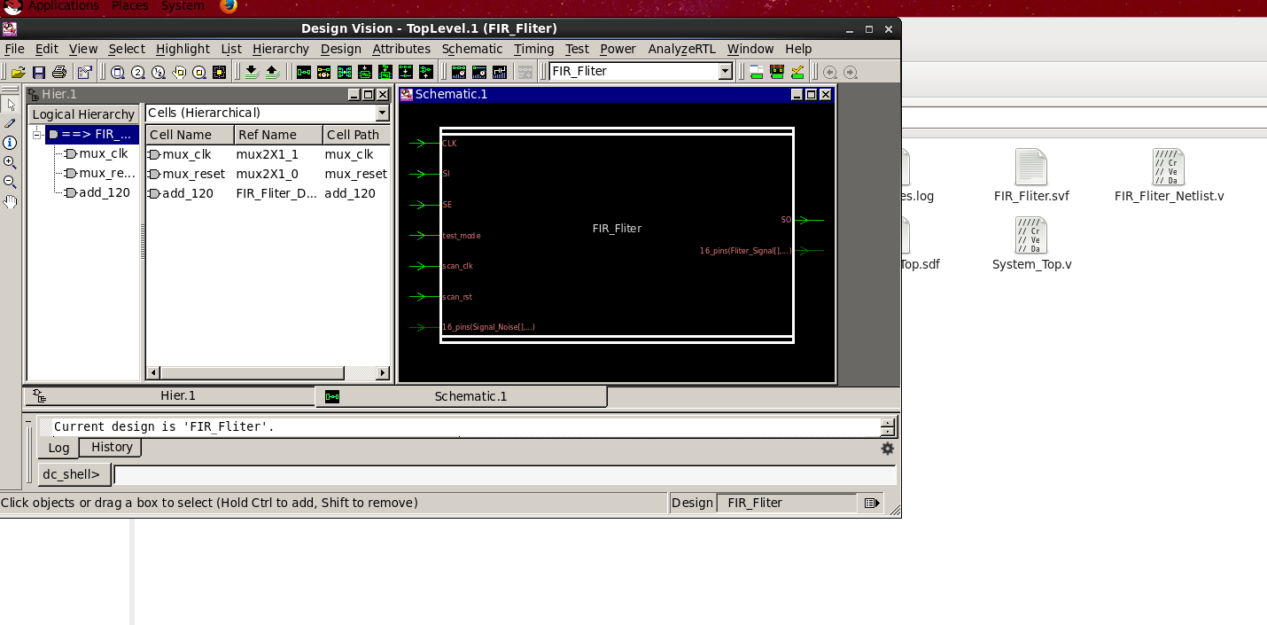

Slide 36
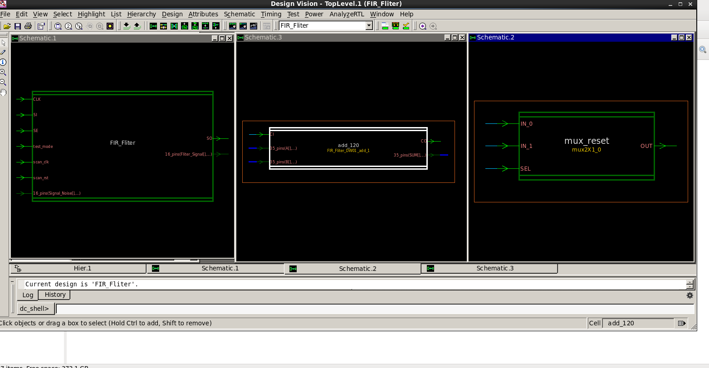

Slide 37
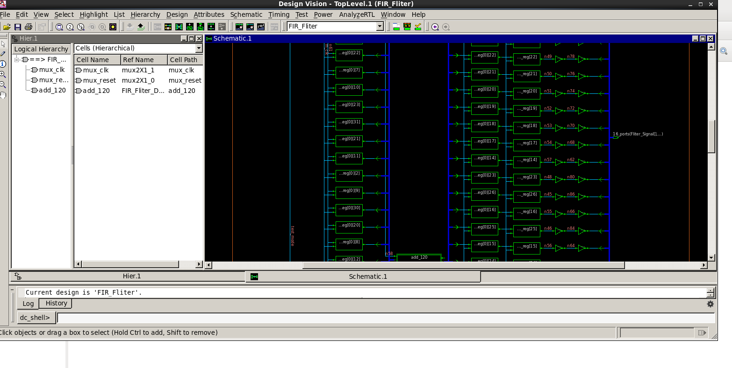

Slide 38
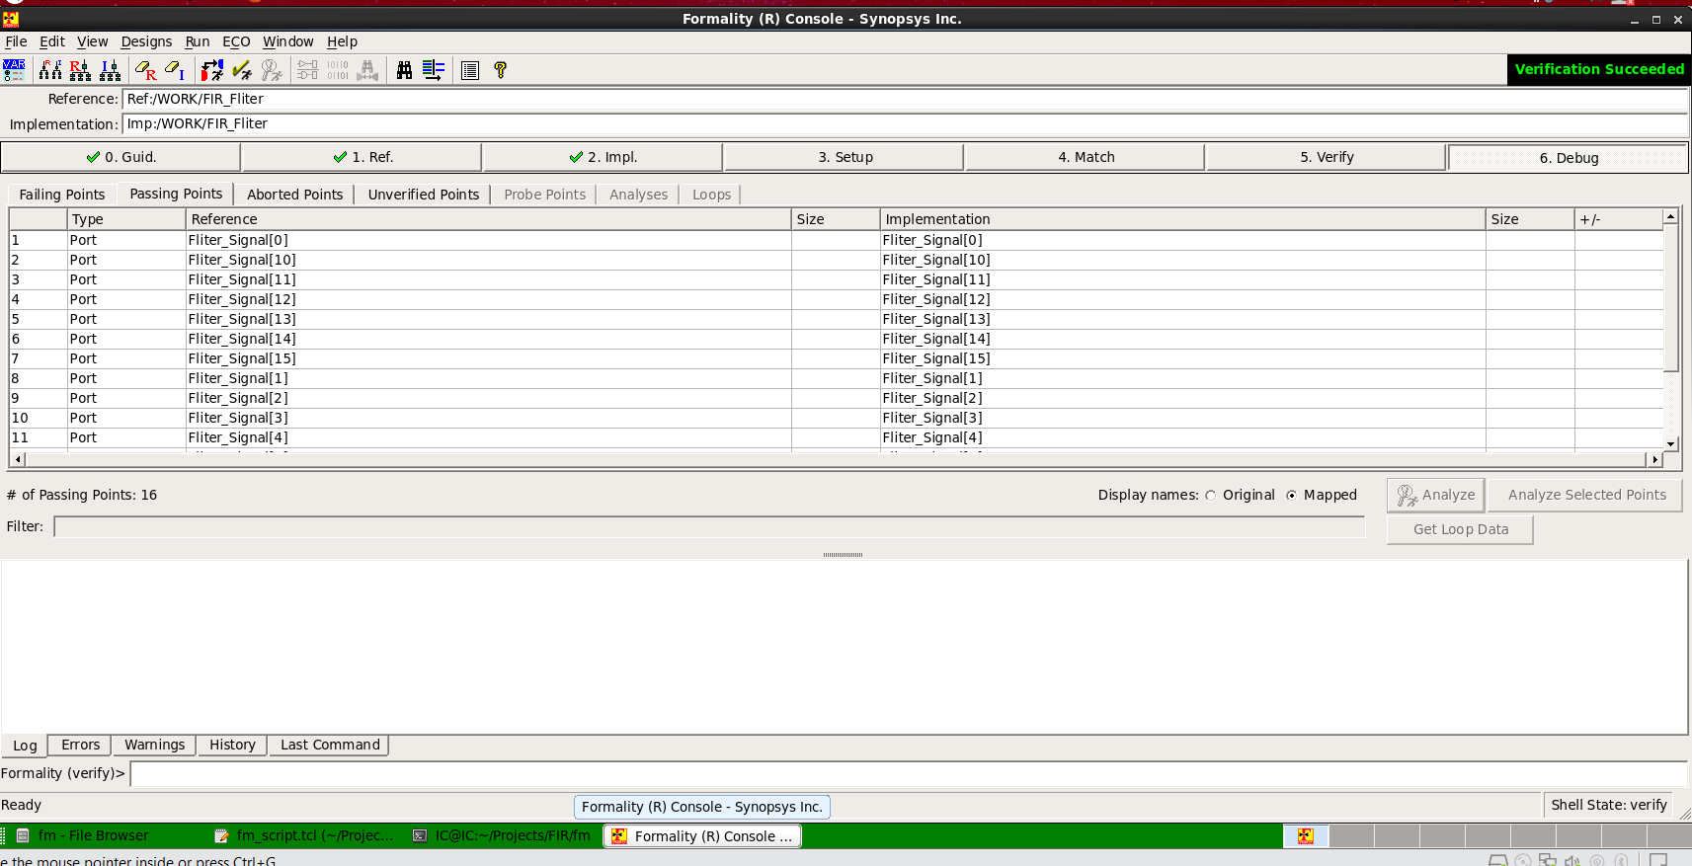

Slide 39
Reports

Slide 40
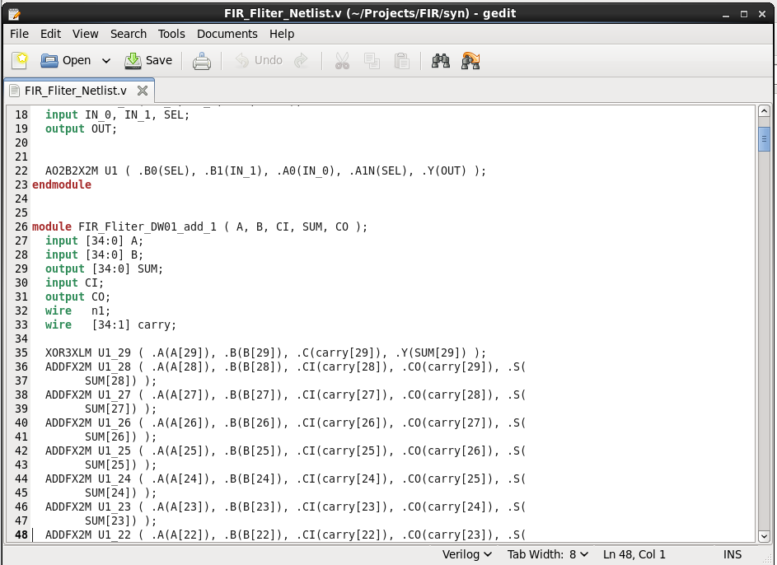
FIR Filter Netlist

Slide 41
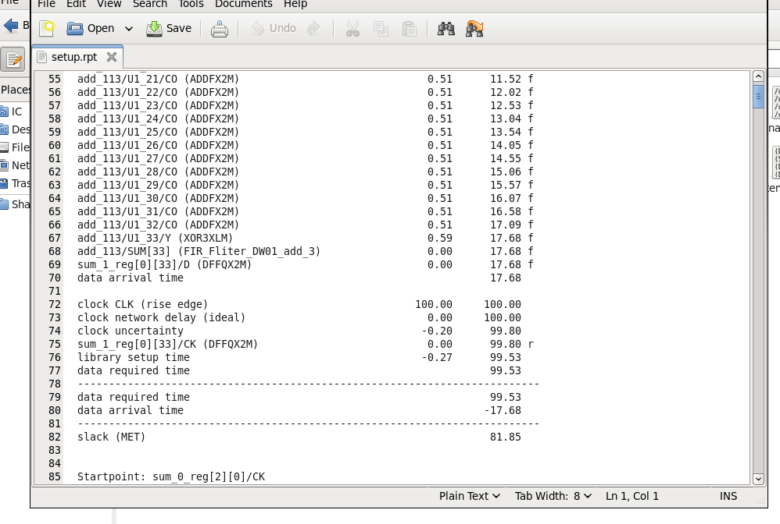
Setup report

Slide 42
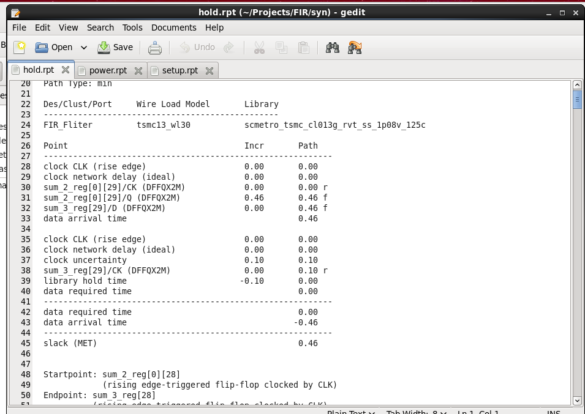
Hold report

Slide 43
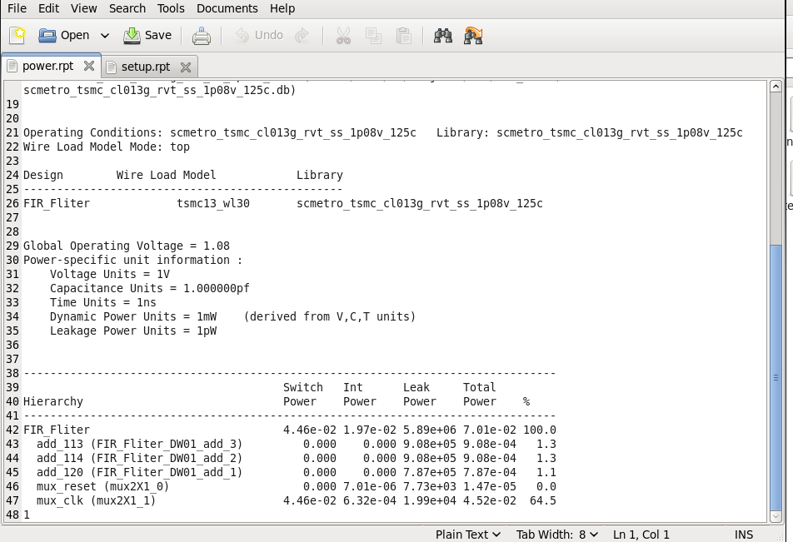
Power report

Slide 44
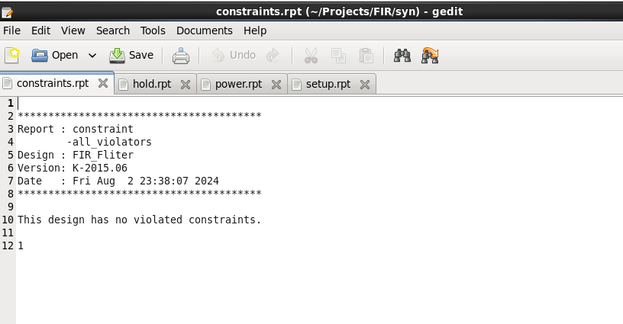
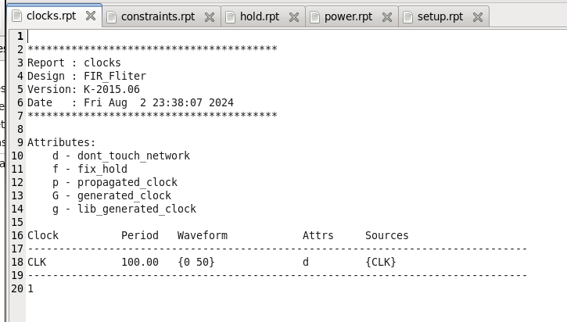
Clocks & Constraints Reports

Slide 45
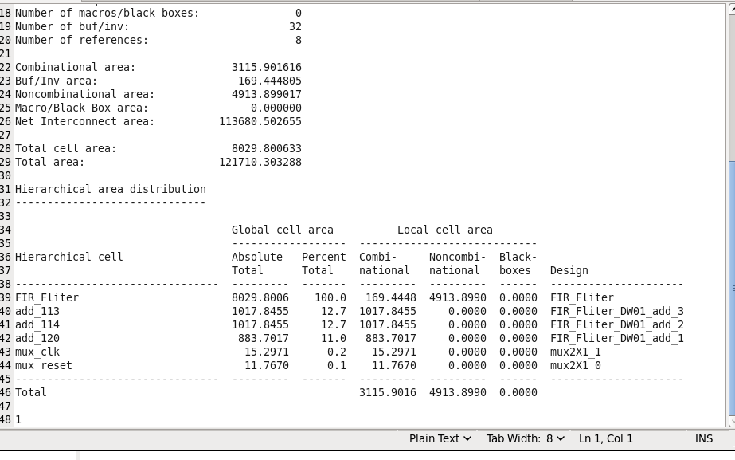
Area report

Slide 46

Coverage report

Slide 47



Slide 48

Area_dft
report

Slide 49


Slide 50

Report of points

Slide 51
PnR (Place and Route)

Slide 52


Slide 53


Slide 54


Slide 55


Slide 56


Slide 57

Final GDS

Slide 58


Slide 59
Refrences
Eng. Nour and Eng.YaseenFIR documentation Eng. Mohamed Tarek Repo
Digital Filter Basics -Akash Murthy
A guide to SDR and DSP using Python - Filters FIR design lecture from Zewil DSP course Pipelined VS Trasnposed FIR - all about circuits
Analog Devices, Inc. Digital Filters paper >> ADI Paper
Intel® Quartus® Prime Pro Edition User Guide: Platform Designer Nios II Classic Software Developer’s Handbook
Avalon® Interface Specifications
Introduction to Platform Designer - Intel Learning Platform Designer Standard Interfaces - Intel Learning
The Nios® II Processor: Introduction to Developing Software - Intel Learning
Custom Component Development Using Avalon® and Arm* AMBA* AXI Interfaces - Intel Learning Forcing Synthesis tool (Preserve for Debug)
Preserve for Debug 2

Slide 60
THANKS
LinkedIn
Email
GitHub
Hamza Ali | LinkedIn
hamzaalimorsi@gmail.com
Hamza-Ali10(github.com)

